Slide 1
Bank Loan Case Study
Presented by – Shweta kushwaha

Slide 2
Project Description
In this project, we aim to analyze a loan dataset at a finance company that specializes in lending various types of loans to urban customers. Company facing a challenge like some customers who don't have a sufficient credit history take advantage of this and default on their loans. We are going to use Exploratory Data Analysis (EDA) to analyze patterns in the data and ensure that capable applicants are not rejected.

Slide 3
Approach
When a customer applies for a loan, company faces two risks:
If the applicant can repay the loan but is not approved, the company loses business.
If the applicant cannot repay the loan and is approved, the company faces a financial loss.
The dataset contains information about loan applications. It includes two types of scenarios:
Customers with payment difficulties: These are customers who had a late payment of more than X days on at least one of the first Y installments of the loan.
All other cases: These are cases where the payment was made on time.
When a customer applies for a loan, there are four possible outcomes:
Approved: The company has approved the loan application.
Cancelled: The customer cancelled the application during the approval process.
Refused: The company rejected the loan.
Unused Offer: The loan was approved but the customer did not use it.

Slide 4
Tech-Stack Used
I used Microsoft excel to read and convert the data frame according to our needs.
I used Microsoft PowerPoint to make the report and graphs to represent the project report clearly.

Slide 5
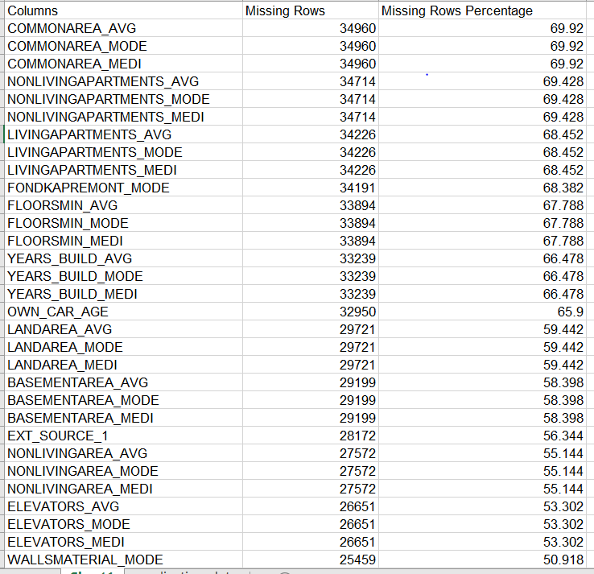
Identifying the missing data in the dataset and decide on an appropriate method to deal with it using Excel built-in functions and features.
Firstly I collected all missing data according to
columns using
=COUNTBLANK(application_data!AW2:AW50000)
Then, sorted the missing row percentage using sorting
function and for finding percentage I divided the
missing rows by total number of rows
=B2/50000*100
I have removed the columns with more than 50%
Blank values.

Slide 6
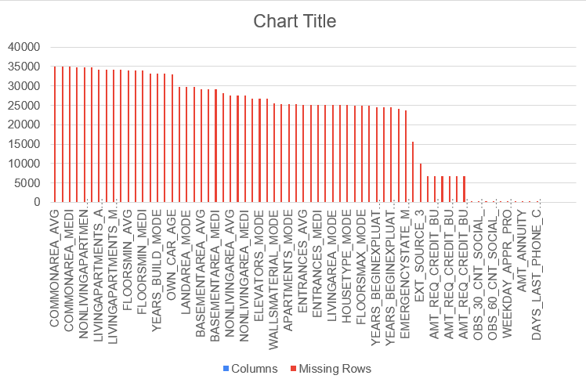
Bar chart for Blank cells as wells for non-blank columns sorted by Highest to Lowest.

Slide 7
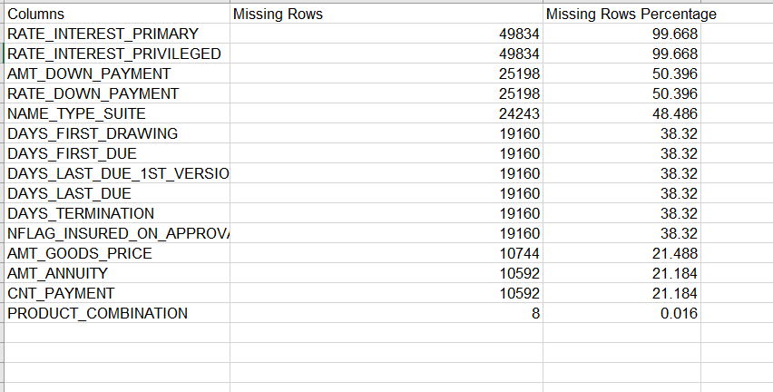
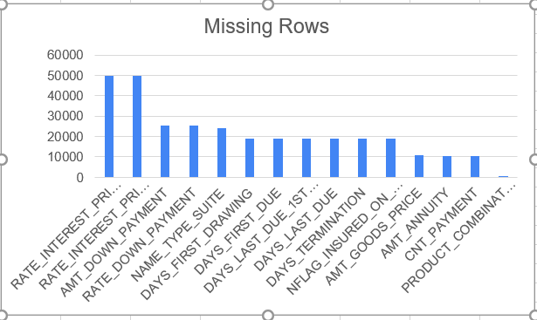
Previous application dataset cleaning
In this files as well I collected all missing data
according to columns using countblank function.
Then, sorted the missing row percentage using
sorting function and for finding percentage I
divided the missing rows by total number of rows.
Bar chart for total percent of missing rows
in the previous application dataset

Slide 8
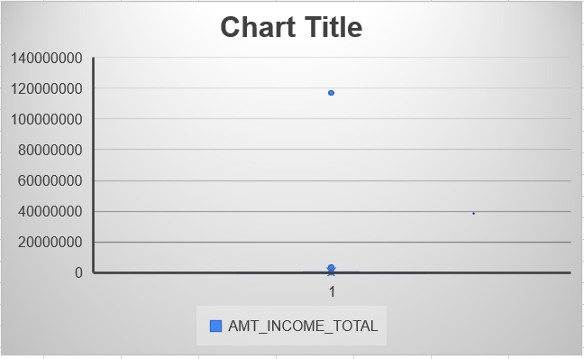
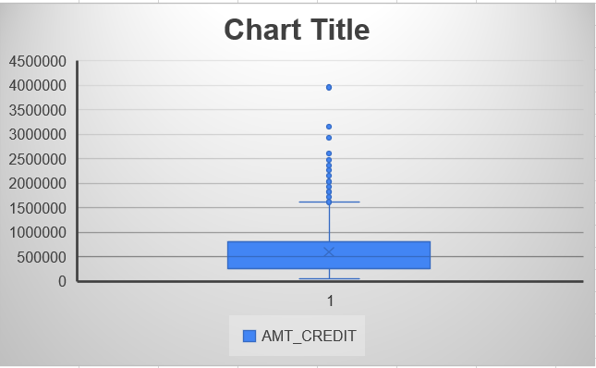
Detect and identify outliers in the dataset using Excel statistical functions and features, focusing on numerical variables.
Outliers in application data are
TOTALAREA_MODE
AMT_CREDIT

Slide 9
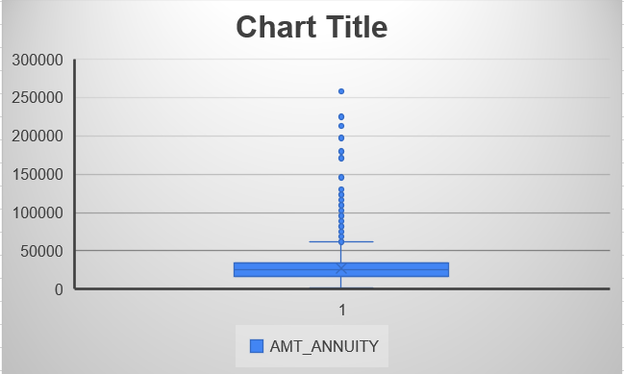
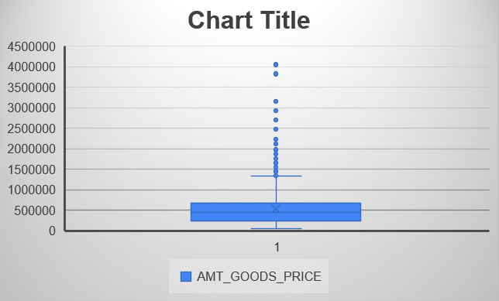
Outliers in application data are
TOTALAREA_MODE
AMT_GOODS_PRICE

Slide 10
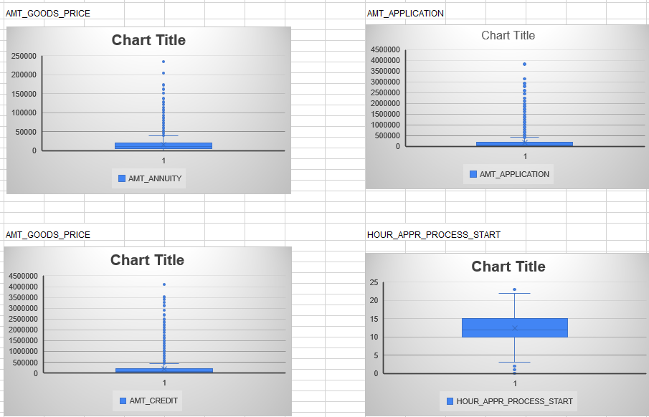
Outliers in previous application are
AMT_GOODS_PRICE
AMT_APPLICATION
AMT_GOODS_PRICE
HOUR_APPR_PROCESS_
START

Slide 11
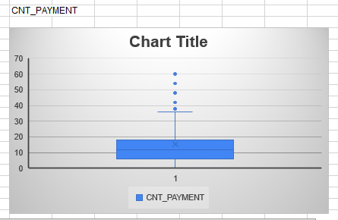
Outliers in previous application are
CNT_PAYMENT

Slide 12
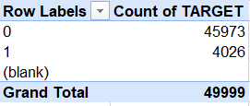
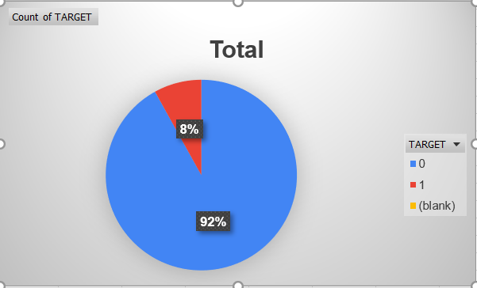
Determine if there is data imbalance in the loan application dataset and calculate the ratio of data imbalance using Excel functions.
There are 2 values in a target column 1 and 0.
‘1’ means client with payment difficulties: he/she had
late payment more than X days on at least one
of the first Y installments of the loan in our
Sample and ‘0’ means all other cases.

Slide 13
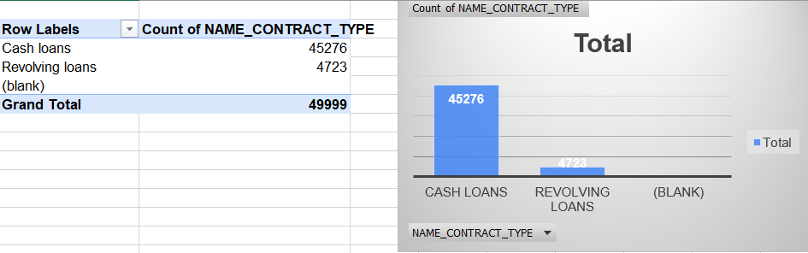
Perform Univariate, Segmented Univariate, and Bivariate Analysis: To gain insights into the driving factors of loan default, it is important to conduct various analyses on consumer and loan attributes.
Univariate Analysis
It focuses on examining and describing individual variables in isolation. It doesn’t deal with the causes or relationship and the main purpose of the analysis is to describe the data and find the pattern exists in it.

Slide 14
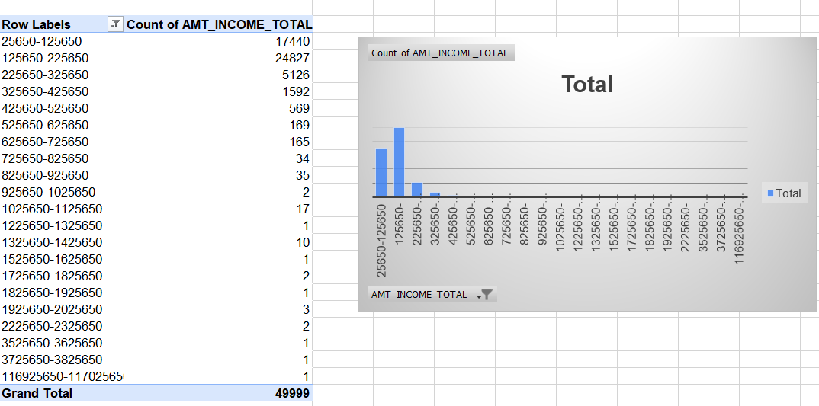
Identification of most of the income of client ranges between 1 lakh to 2 lakh approximately.

Slide 15
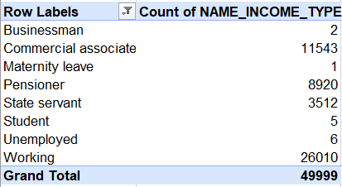
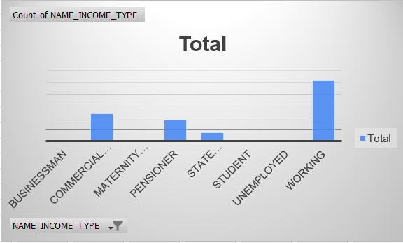
Identification of most client income type who applied for loans are working professionals.

Slide 16
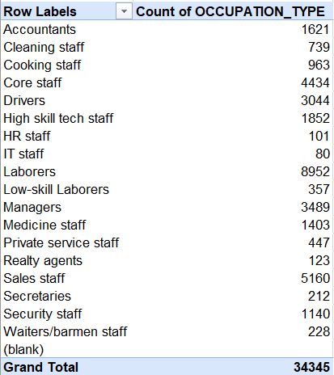
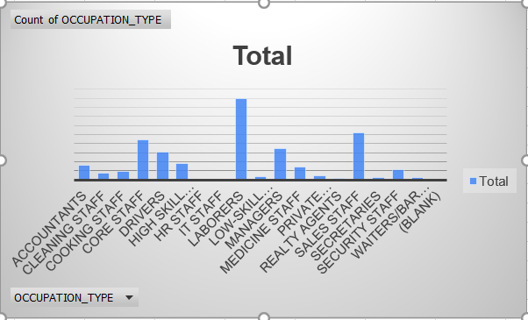
Most of the clients are laborers who applied for loans.
.

Slide 17
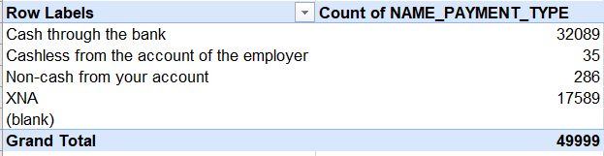
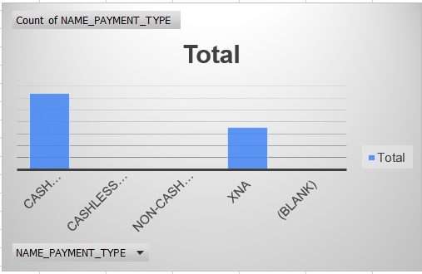
Payment method that most client chose to pay for the previous application are cash through the bank.

Slide 18
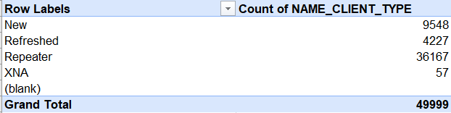
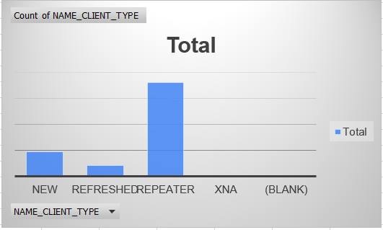
Most of the clients are repeater when applying for the previous application

Slide 19
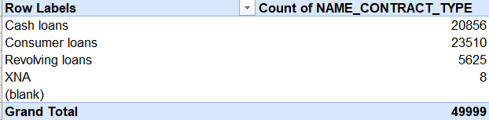
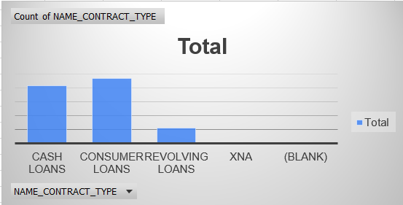
Contract product type of the previous application are consumer loans.

Slide 20
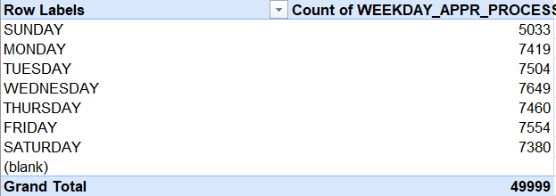
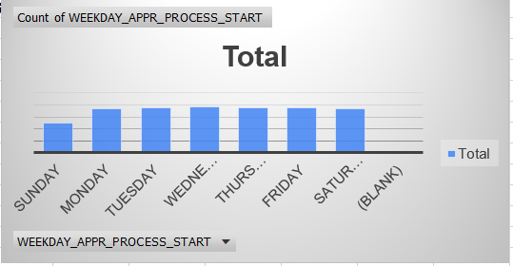
On weekdays (Monday to Saturday) most of the client apply for previous application.

Slide 21
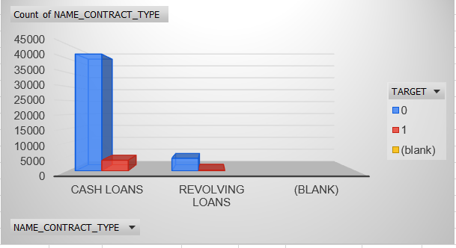
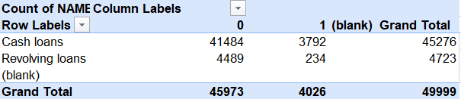
Perform Univariate, Segmented Univariate, and Bivariate Analysis:
Segmented Univariate Analysis
It is an extension of univariate analysis that involves splitting the dataset into specific segments or groups based on a chosen criterion or variable.
Identification if loan is either cash or revolving with target variable, this understands that the defaulters to paying loans by contract type.

Slide 22
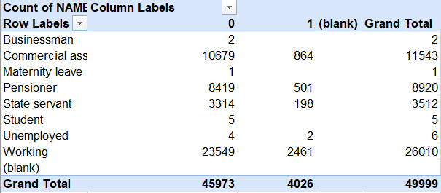
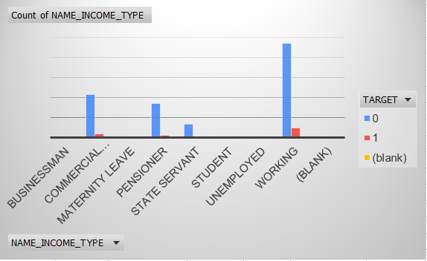
Identification of the income type with target variable.

Slide 23
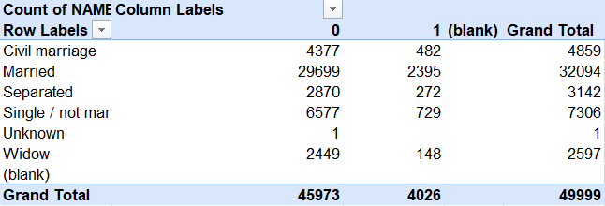
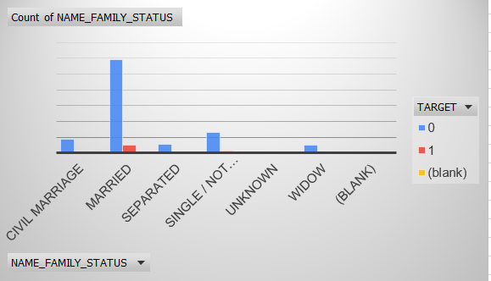
Identification of the client family status with target variable.

Slide 24
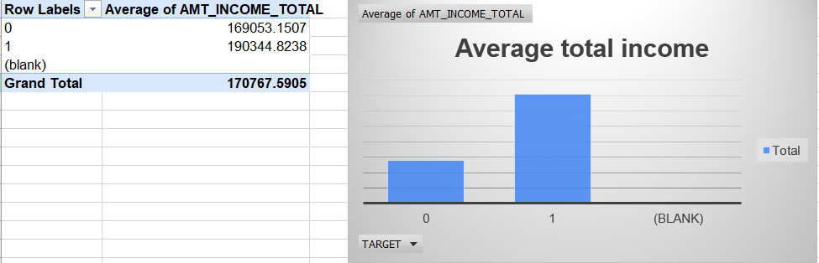
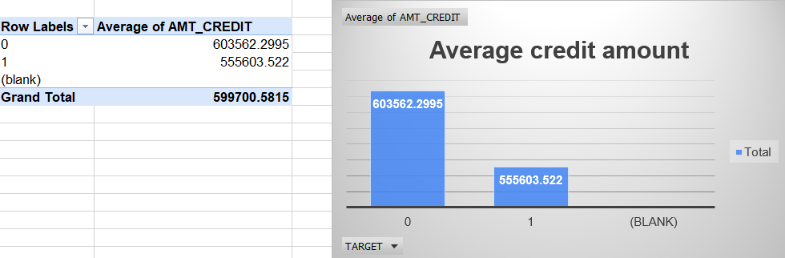
Identification of the average total income and average credit amount type with target variable.
.

Slide 25
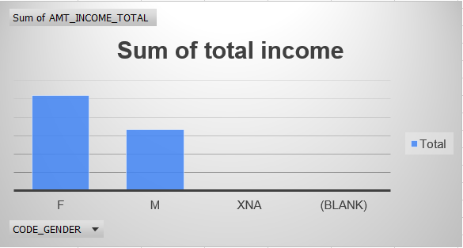
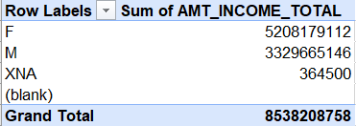
Perform Univariate, Segmented Univariate, and Bivariate Analysis:
Bivariate Analysis
It refers to the data contains two different variables. It deals with causes and relationship and the main purpose of analysis is to find the relationship among two variables.

Slide 26
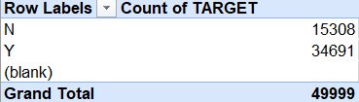
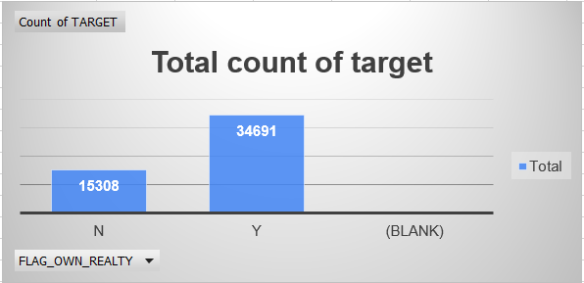
Most of the clients owns a house or flat.

Slide 27
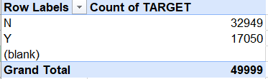
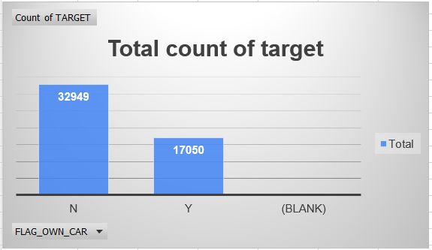
Most of the clients who applied for loan are having their own car.

Slide 28
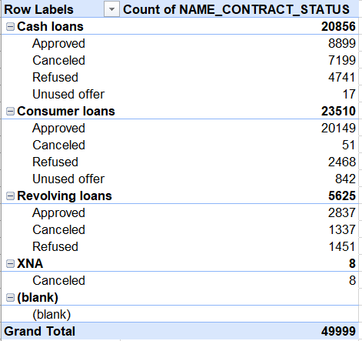
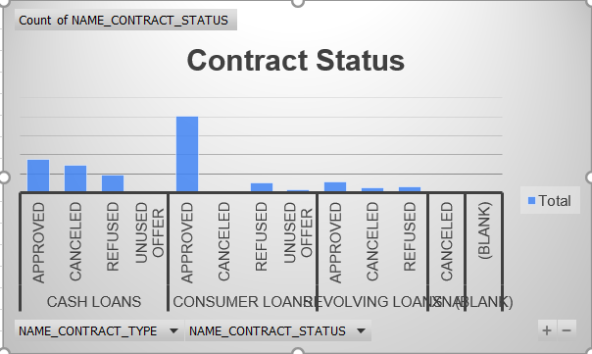
Most of the clients took consumer loans and the consumer loans are approved more compared to any other loans.

Slide 29
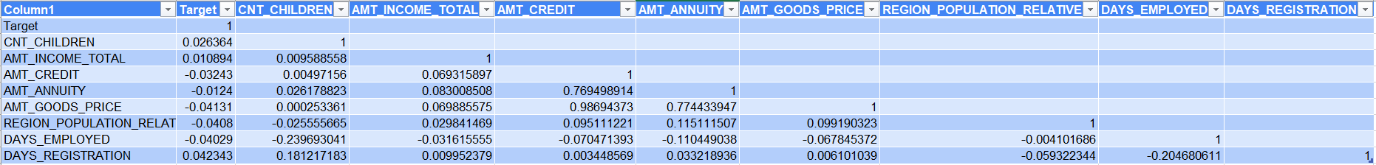
Identify Top Correlations for Different Scenarios: Understanding the correlation between variables and the target variable can provide insights into strong indicators of loan default.
For Application data

Slide 30
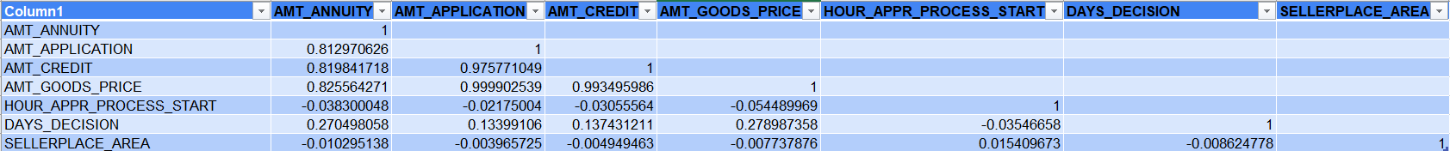
Identify Top Correlations for Different Scenarios: Understanding the correlation between variables and the target variable can provide insights into strong indicators of loan default.
For Previous application data

Slide 31
Insights
The bank needs to address outliers and payment difficulties to minimize risks associated with defaulted clients.
The imbalanced dataset necessitates the use of appropriate techniques to handle class imbalance during modeling.
Payment method that most client chose to pay for the previous application are cash through the bank.
Clients with limited employment experience may require closer scrutiny during loan approval.
Most of the clients took consumer loans and the consumer loans are approved more compared to any other loans.

Slide 32
RESULT
This project helps in understand why data cleaning is most important step in analysis a particular dataset.
Gained deeper knowledge on how we can identify outliers in the dataset and how important they are to identify
Data imbalance in the dataset help in understand the inaccuracy of our analysis
How to draw chart based on different scenarios and pivot tables
Finding the correlation between different variables.
For more details you can visit excel, please click here

Slide 33
Thank you!

